Slide 1
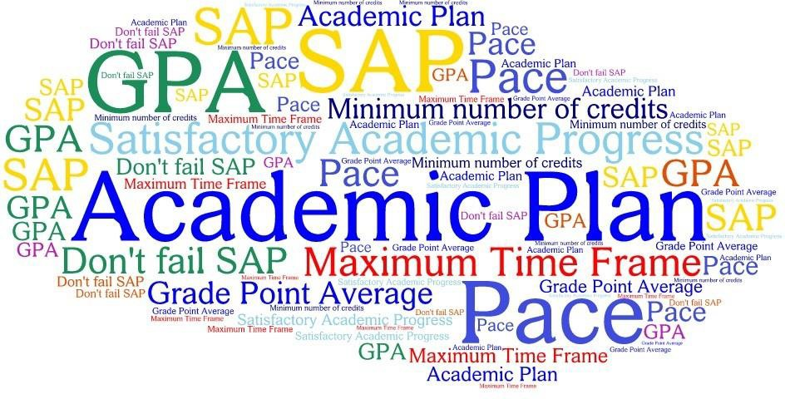
Navigating the SAP Appeal Process for Student Success

Slide 2
What is SAP ?
Academic standards that must be met to maintain Financial Aid eligibility.
Standards:
Student must complete their Academic Program within 150% required credits
Maintain at least 67% Completion Rate of Attempted Credits
Maintain a minimum cumulative GPA of 2.0

Slide 3

What is SAP and Why It Matters
SAP are federal guidelines to ensure students make satisfactory progress in their educational programs
Maintaining SAP is essential to avoid losing financial aid and ensure continued education funding
SAP affects eligibility for multiple financial aid types including grants, loans, and work-study programs
SAP encourages timely program completion and effective use of federal and institutional resources

Slide 4
Setting up your Appeal
Review your unofficial transcripts
Signed personal statement detailing extenuating circumstances for each unsuccessful term.
Submit supporting documents
Provide supporting documents for each term in question.
Determine which terms you did not pass.
Examples may include but are not limited to:
Death or birth records Divorce decrees Hospital records Eviction notices Travel papers Employment records Coronavirus (COVID-19) | Signed statement from attending doctor Copy of Police Report Copy of insurance claims Military orders Court records

Slide 5


Steps to Submitting SAP Appeal for Committee Review
Signed Statement
Supporting Documentation
Signed Faculty/Advisor Overview Form My Academic Plan (M.A.P)
SAP Request Form

Slide 6

Questions About SAP?
For questions regarding Standards of Academic Progress (SAP) please contact the Financial Aid Office for assistance (305) 237-9300.
Hialeah: Lfinaid@mdc.edu Homestead: Hfinaid@mdc.edu Kendall: Kfinaid@mdc.edu Medical: Mfinancialaid@mdc.edu North: Nfinaid@mdc.edu
Padron: PadronFinancialAid@mdc.edu West: Westfinaid@mdc.edu
Wolfson: Wfinaid@mdc.edu

